Slide 1
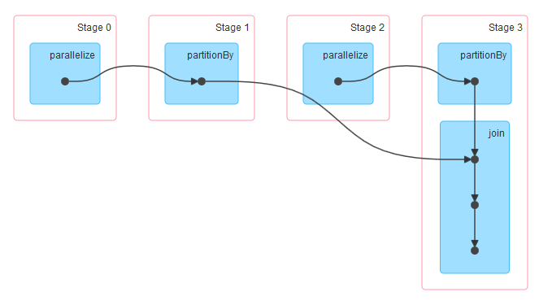
RDD
Resilient Distributed Dataset
Transformation
Spark Operation
DAG
Edge : RDD Operation
Nodes : RDD
DAG
Scheduler
generates stage oriented scheduling using tasks
Task
Data – Need
Computation - Need
Set of Tasks
<Taskset>
Task Manager/scheduler
These two units decides
Which task to be executed on which machine/slave.
Cluster Manager
Task - N
Task - M
Executor
Executor
Executor is a distributing agent responsible for executing given task
(by cluster manager)
Task slot
Task slot
Slave 1
Worker Node
Slave N
Worker Node

